Slide 1
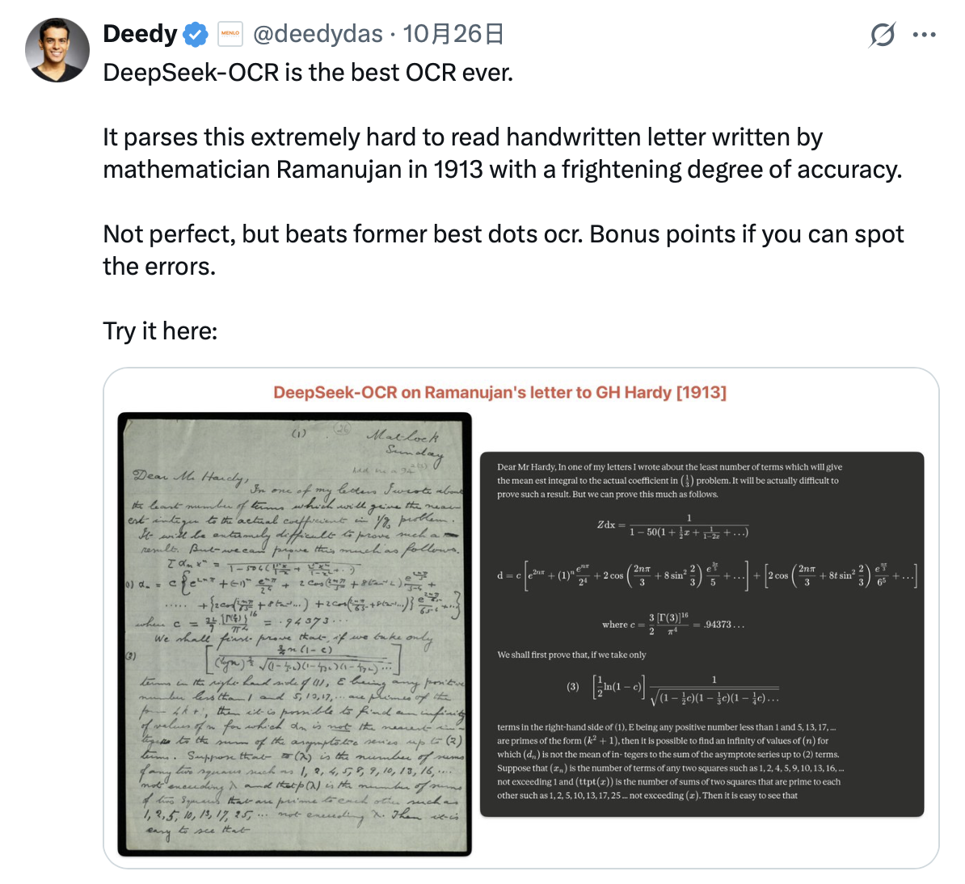

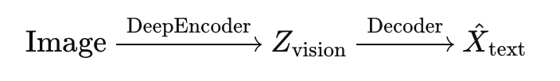
DeepSeek-OCR: Contexts Optical Compression^{[1]}
Haoran Wei, Yaofeng Sun, Yukun Li
DeepSeek-AI
12312110 李轩然

Slide 2
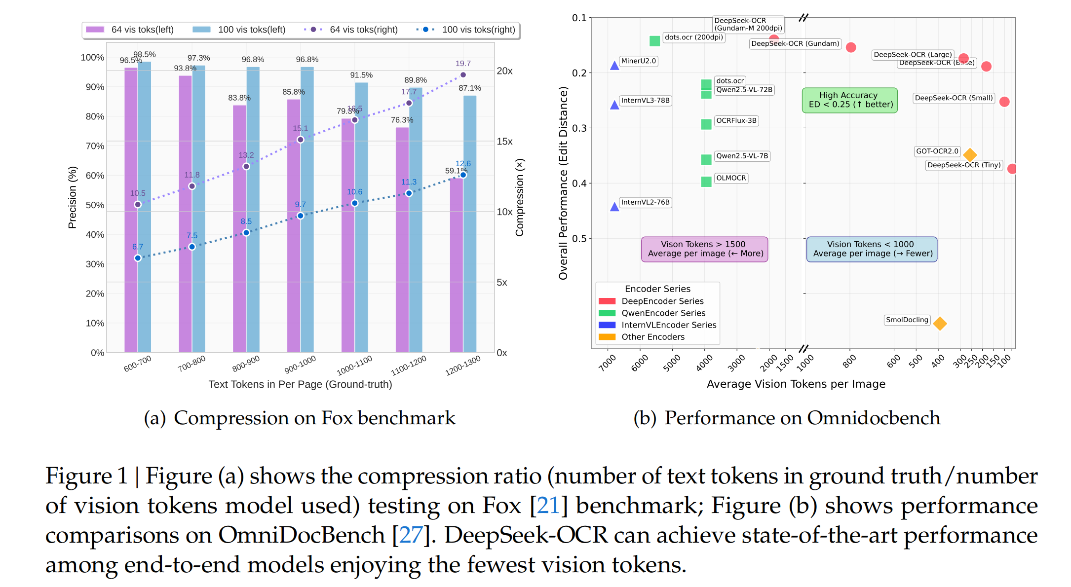
Quantitative analysis of vision-text token compression ratios
It achieves 96%+ OCR decoding precision at 9-10× text compression, ∼90% at 10-12× compression, and ∼60% at 20× compression on Fox benchmarks.

Slide 3
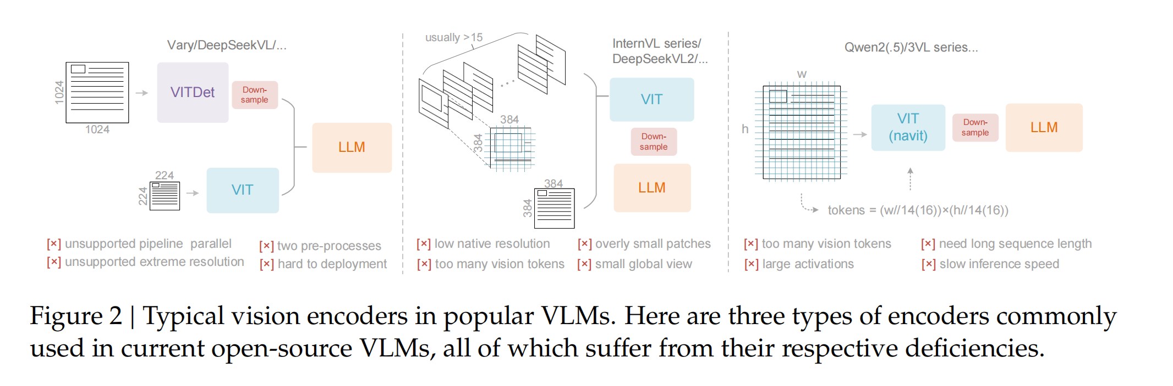
Typical Vision Encoders in VLMs
1. Dual-tower architecture represented by Vary^{[2]}
2. Tile-based method exemplified by InternVL2.0^{[3]}
3. Adaptive resolution encoding represented by Qwen2-VL^{[4]}
For a document containing 1000 words, how many vision tokens are at least needed for decoding?

Slide 4
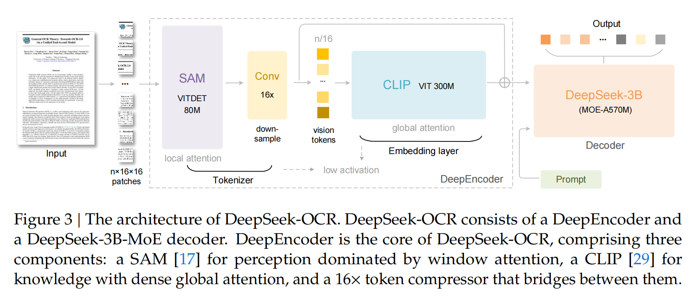
DeepSeek-OCR Architecture
To explore the feasibility of contexts optical compression, we need a vision encoder with the following features: 1. Capable of processing high resolutions; 2. Low activation at high resolutions; 3.Few vision tokens; 4. Support for multiple resolution inputs; 5. Moderate parameter count.

Slide 5
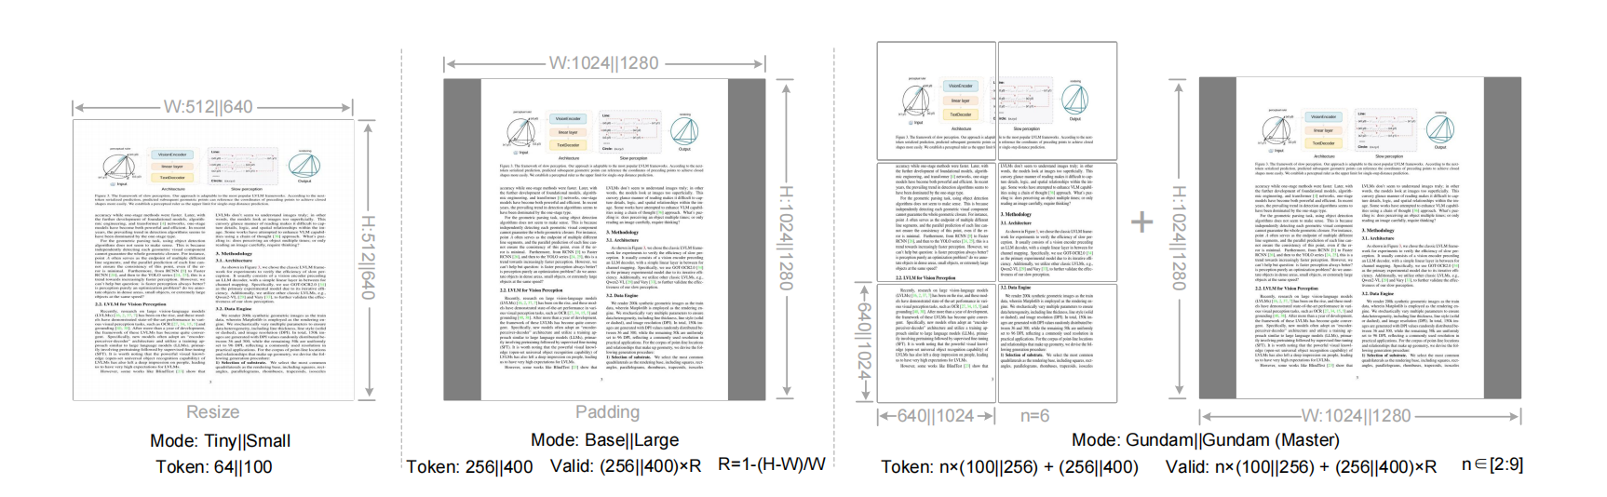
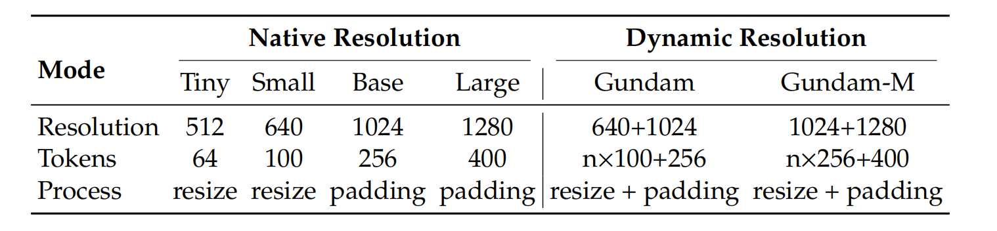
Multiple resolution modes
For Tiny and Small, directly resize the original shape; for Base and Large, images are padded to the corresponding size, and the number of valid vision tokens becomes:
where w and h represent the width and height of the original input image.

Slide 6
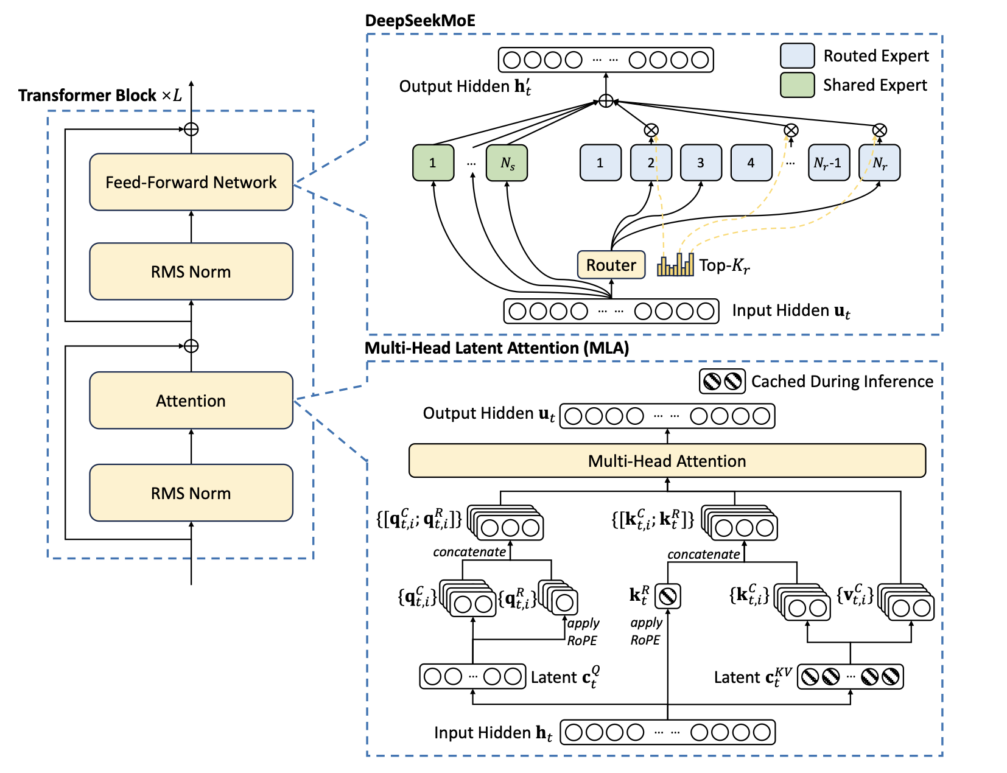
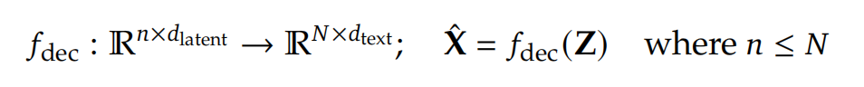
The MoE Decoder
We use DeepSeekMoE^{[5]}.
The decoder reconstructs the original text representation from the compressed latent vision tokens of DeepEncoder as:
The function 𝑓_{dec} represents a non-linear mapping that can be effectively learned by compact language models through OCR-style training.

Slide 7
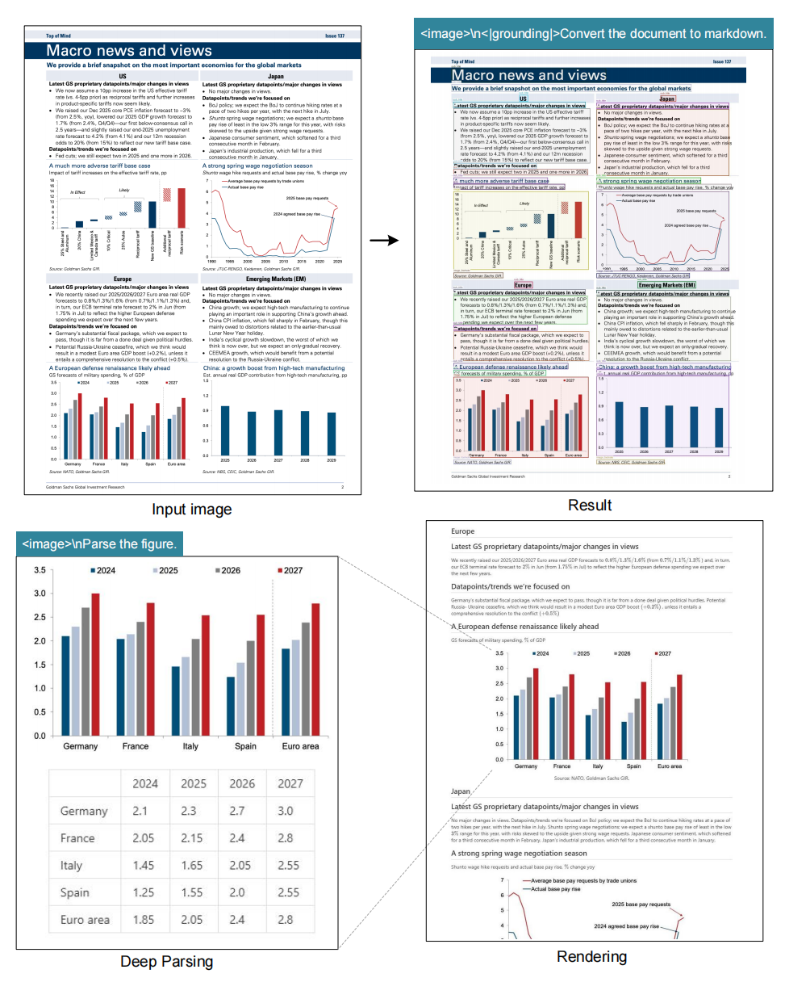
Multimodal data
OCR 1.0
30M pages PDF with about 100 languages

Slide 8
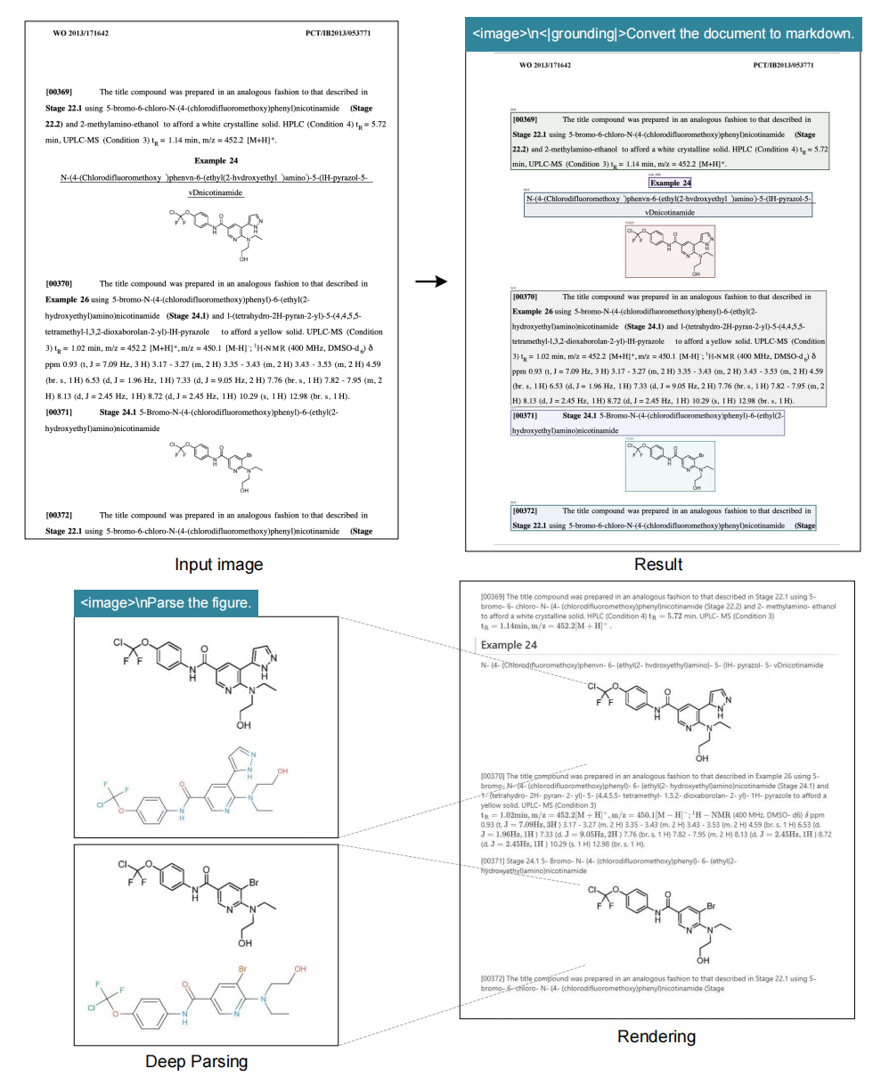
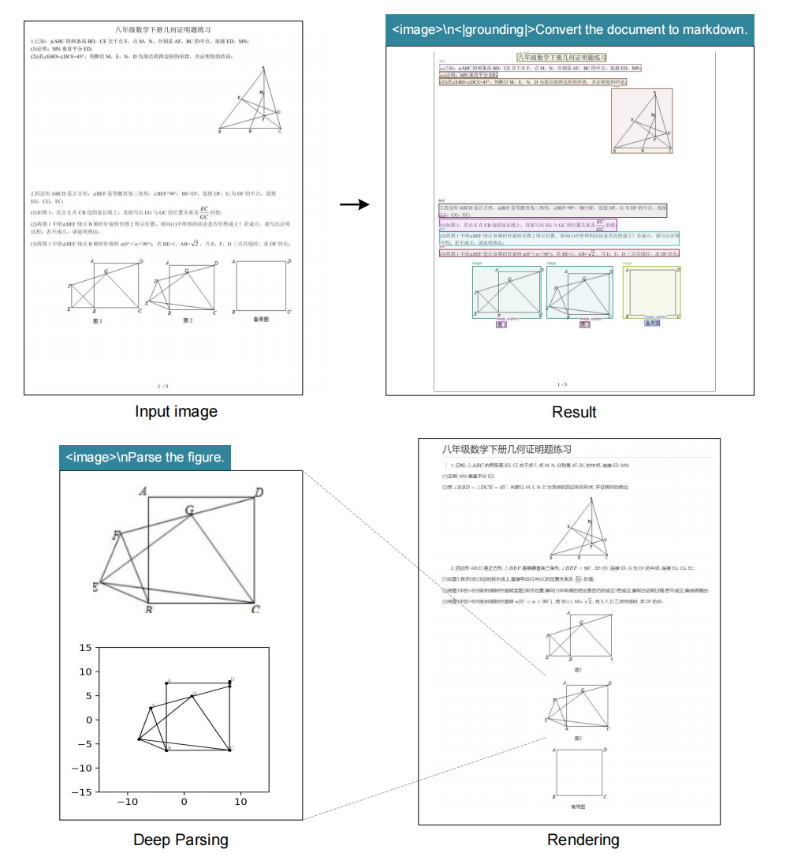
Multimodal data
OCR 2.0
10M images, 5M chemical formula, 1M plane geometry.

Slide 9
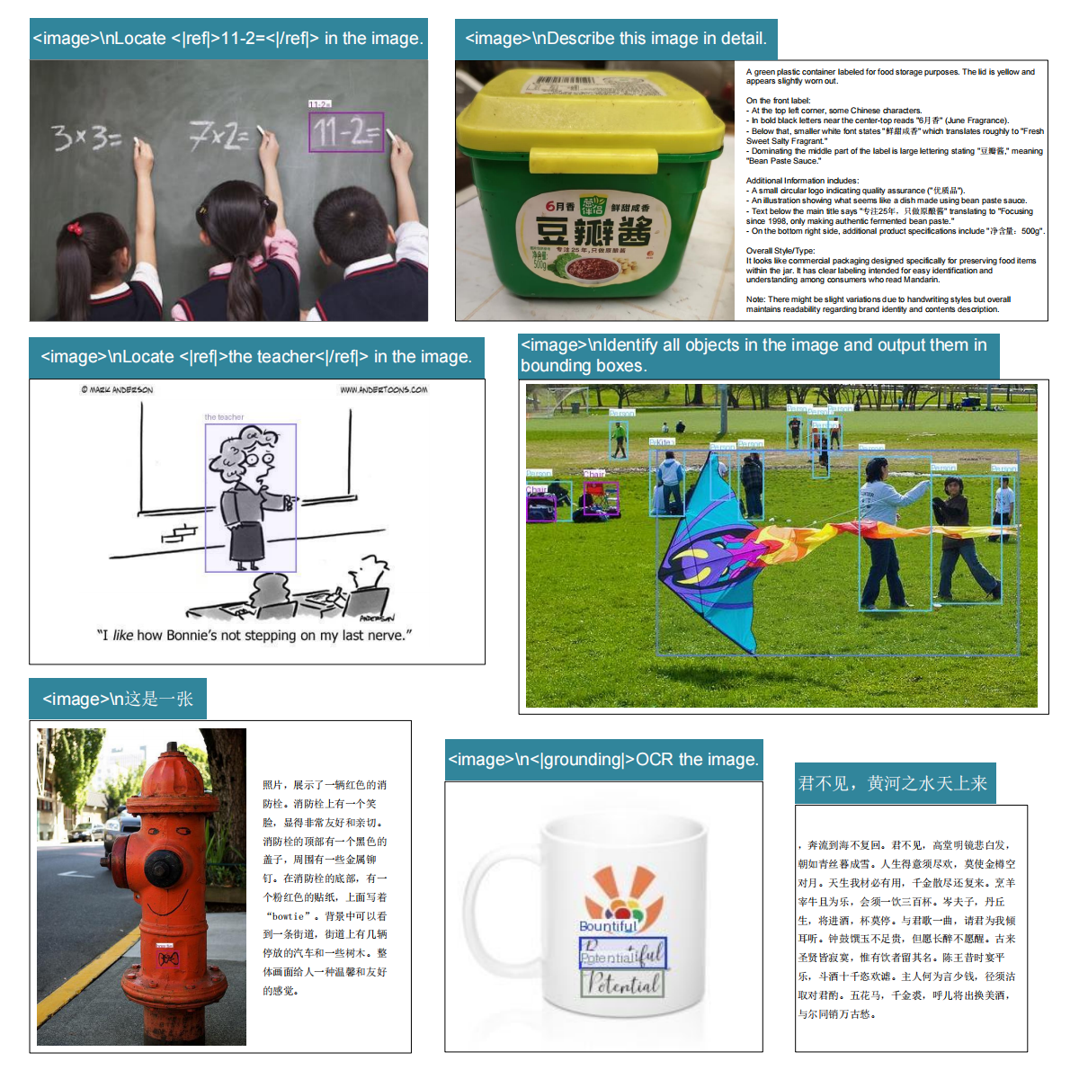
Multimodal data
General vision data

Slide 10
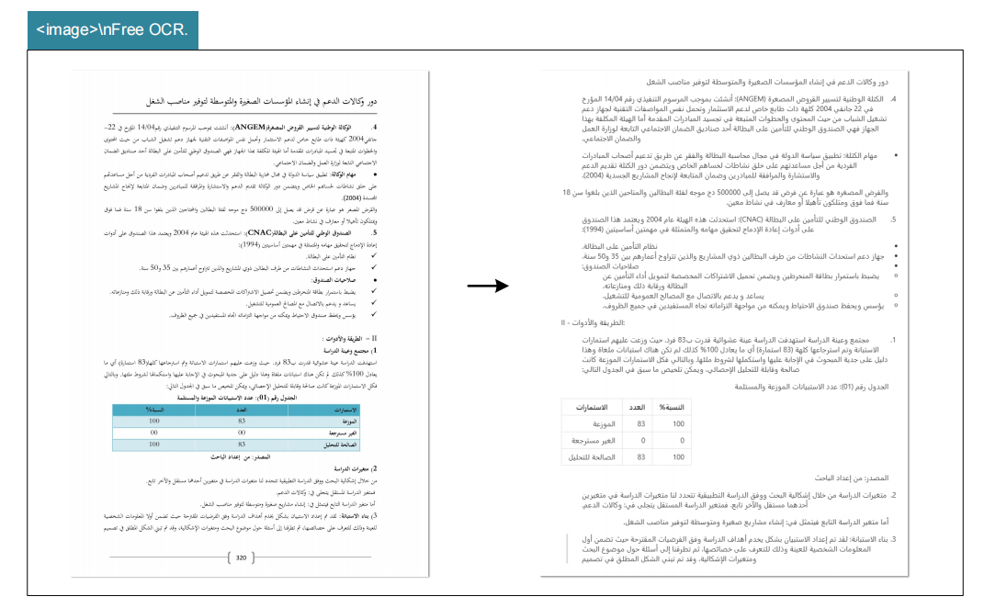
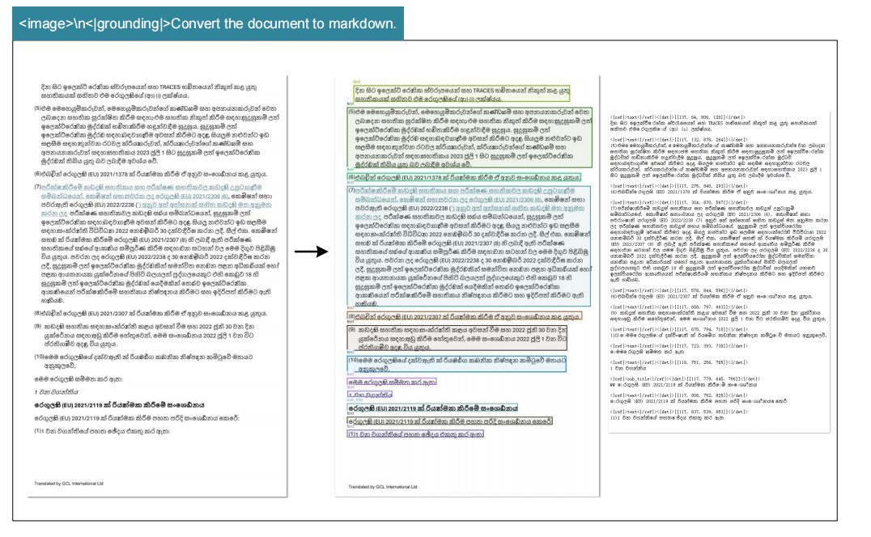
Multimodal data
Text-only data (Multilingual)

Slide 11
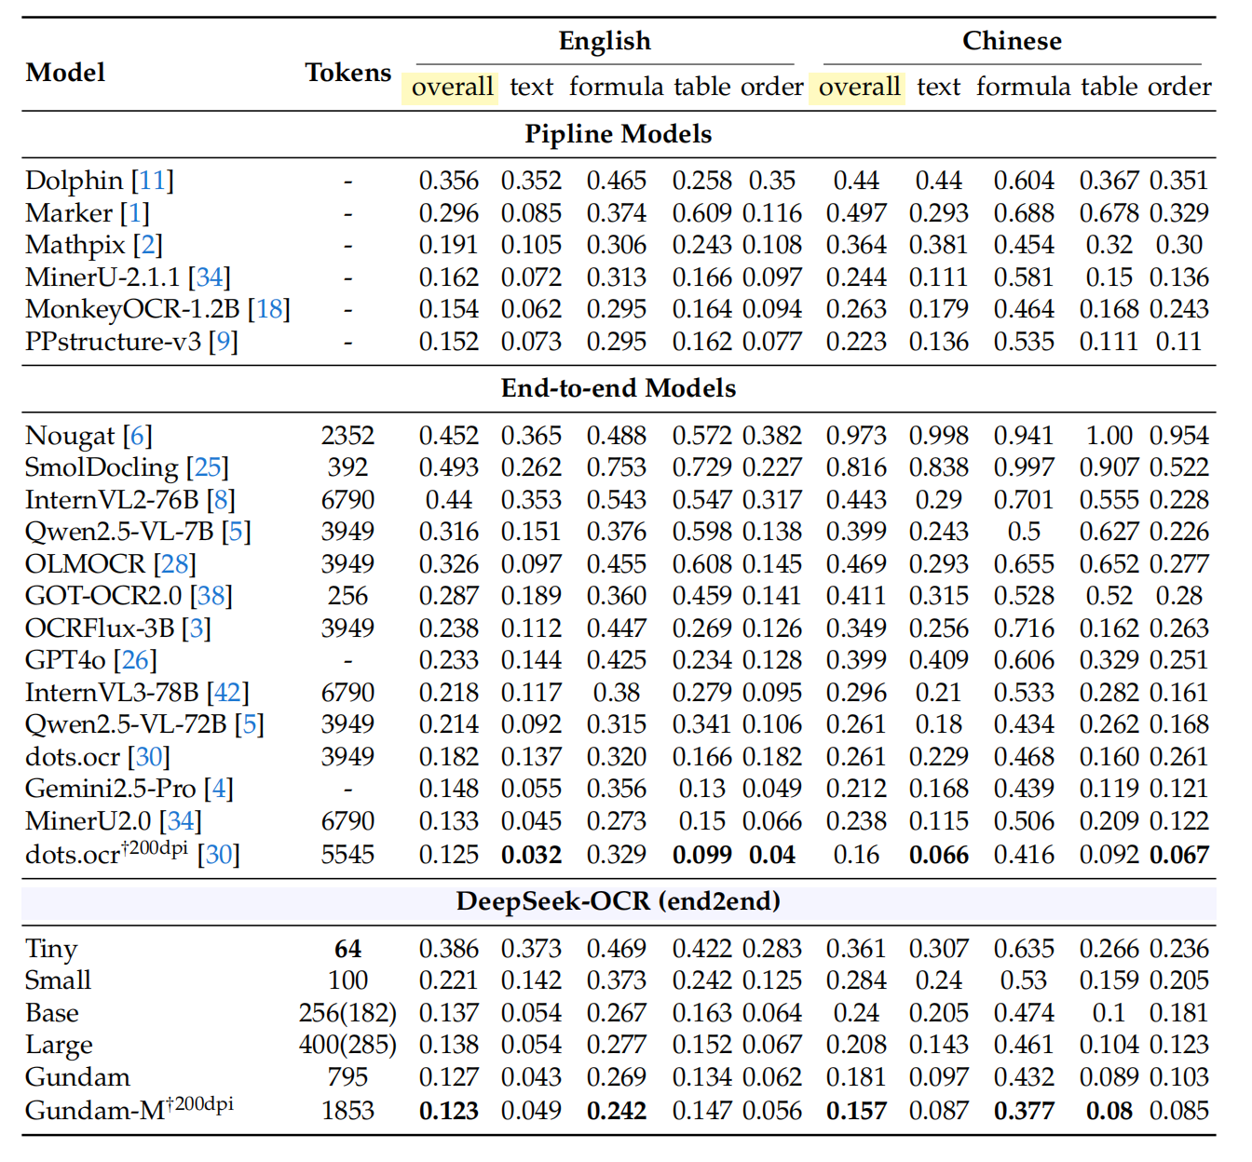
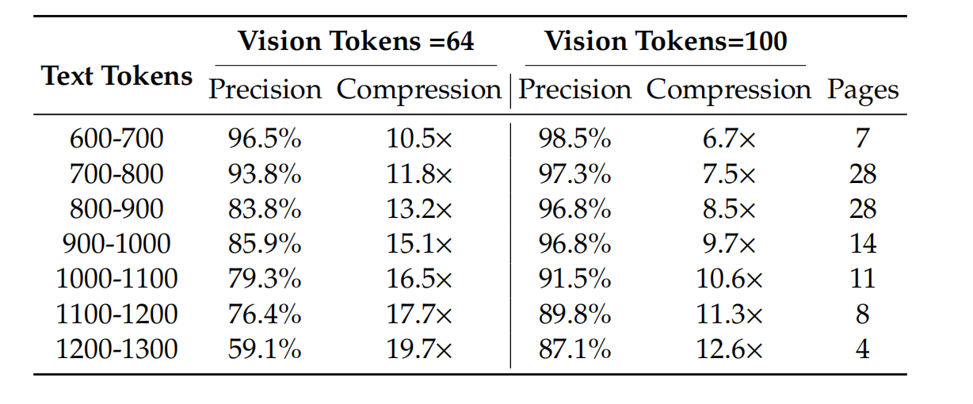
Training results
Edit distances, smaller values indicate better performance.
Benchmark: OmniDocBench^{[7]}.
DeepSeek-OCR’s vision-text compression ratio. Benchmark: Fox^{[6]}.

Slide 12
References
[1] H.R. Wei, Y.F. Sun, Y.K. Li. Deepseek-OCR: Contexts Optical Compression. arXiv preprint arXiv:2510.18234, 2025
[2] H. Wei, L. Kong, J. Chen, L. Zhao, Z. Ge, J. Yang, J. Sun, C. Han, and X. Zhang. Vary: Scaling up the vision vocabulary for large vision-language model. In European Conference on Computer Vision, pages 408–424. Springer, 2024.
[3] Z. Chen, W. Wang, H. Tian, S. Ye, Z. Gao, E. Cui, W. Tong, K. Hu, J. Luo, Z. Ma, et al. How far are we to gpt-4v? closing the gap to commercial multimodal models with open-source suites. arXiv preprint arXiv:2404.16821, 2024.
[4] P. Wang, S. Bai, S. Tan, S. Wang, Z. Fan, J. Bai, K. Chen, X. Liu, J. Wang, W. Ge, et al. Qwen2-vl: Enhancing vision-language model’s perception of the world at any resolution. arXiv preprint arXiv:2409.12191, 2024.
[5] A. Liu, B. Feng, B. Wang, B. Wang, B. Liu, C. Zhao, C. Dengr, C. Ruan, D. Dai, D. Guo, et al. Deepseek-v2: A strong, economical, and efficient mixture-of-experts language model. arXiv preprint arXiv:2405.04434, 2024.
[6] C. Liu, H. Wei, J. Chen, L. Kong, Z. Ge, Z. Zhu, L. Zhao, J. Sun, C. Han, and X. Zhang. Focus anywhere for fine-grained multi-page document understanding. arXiv preprint arXiv:2405.14295, 2024.
[7] L. Ouyang, Y. Qu, H. Zhou, J. Zhu, R. Zhang, Q. Lin, B. Wang, Z. Zhao, M. Jiang, X. Zhao, et al. Omnidocbench: Benchmarking diverse pdf document parsing with comprehensive annotations. In Proceedings of the Computer Vision and Pattern Recognition Conference, pages 24838–24848, 2025.

